Slide 1

Scala
Object-oriented VS functional paradigms

Slide 2
Introduction
SCALA
Scala is pure object-oriented
every value is an object as in Ruby
no primitive values unlike Java
Scala is statically typed
Scala has type inference
Scala has 2 types of variables: immutable (val) + mutable (var)

Slide 3
Object-oriented
paradigm

Slide 4
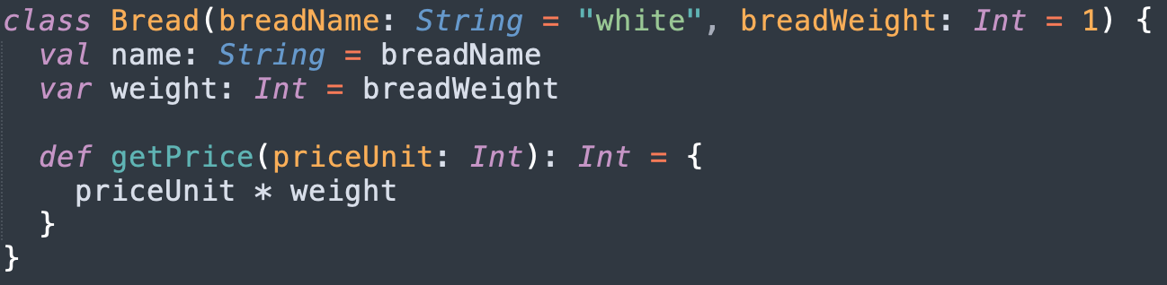
Basics
Object-oriented paradigm
Classes, fields, constructors, methods
May assign default values in constructor definition
The return value of a method is the result of the last instruction in the method

Slide 5
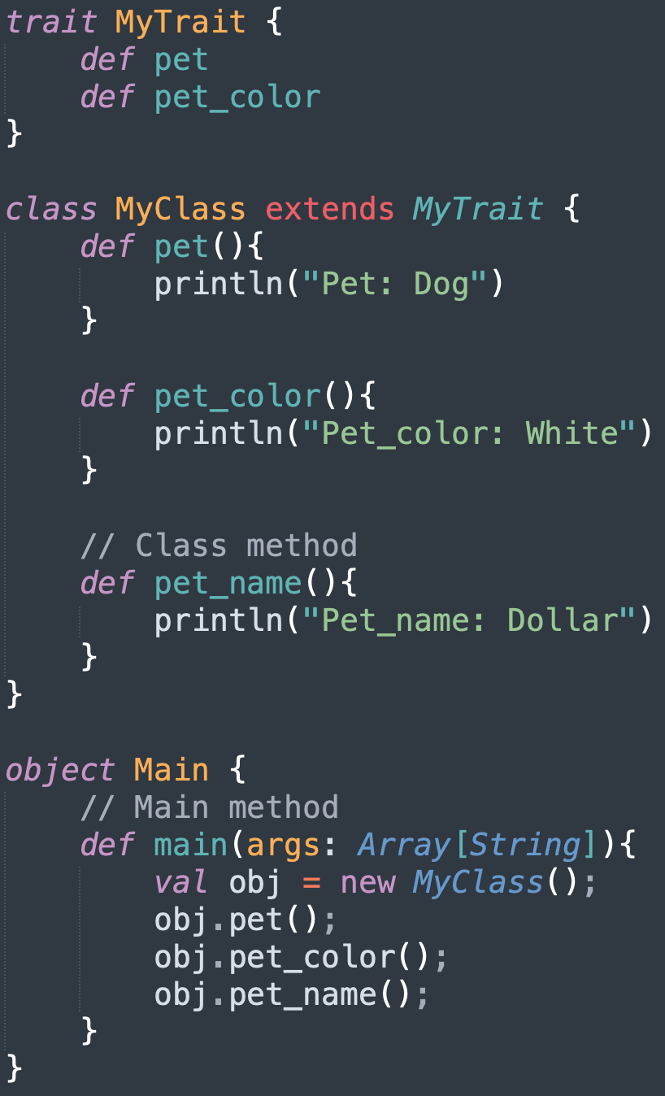
Basics
Object-oriented paradigm
Types and behaviours of objects are described by classes and traits
Traits are used to share interfaces and fields between classes
Traits are similar to interfaces in Java: can be extended by objects + classes, cannot be instantiated

Slide 6
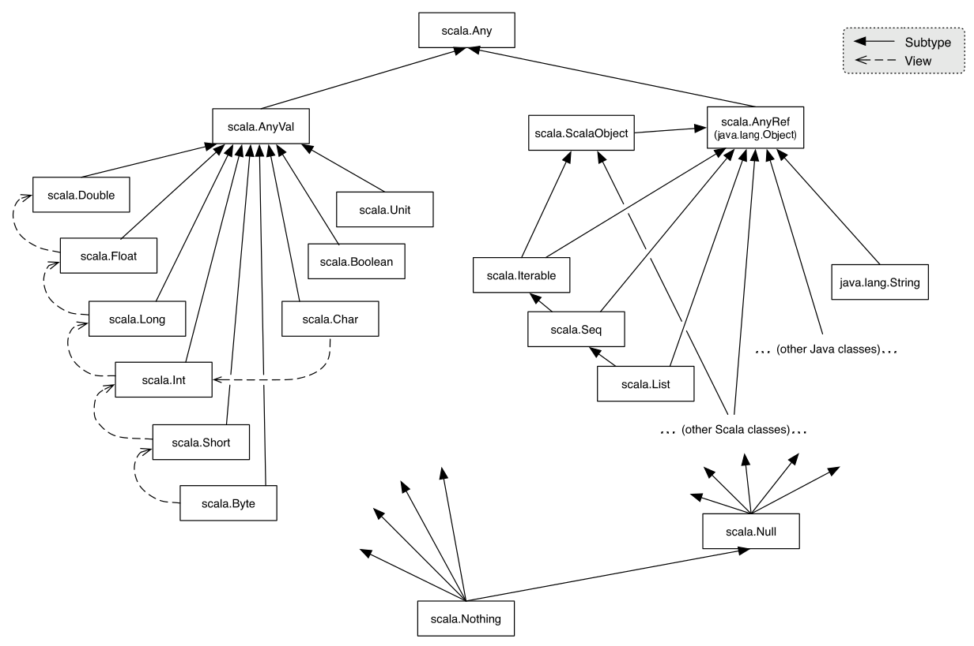

Slide 7
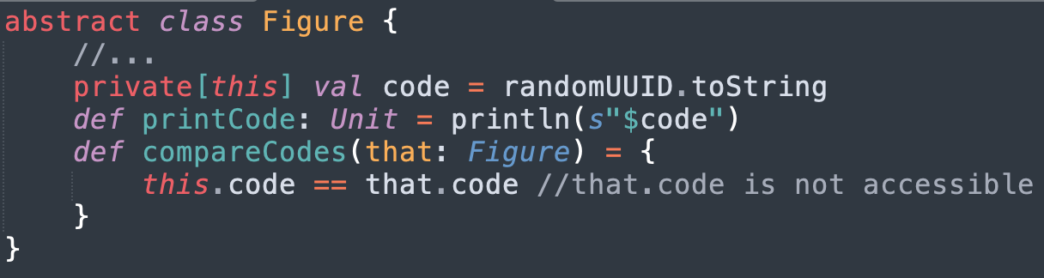
Encapsulation
Object-oriented Principles
Access modifiers: public, private, protected
Public by default, no public keyword
private[this] = prevent access outside the object scope

Slide 8
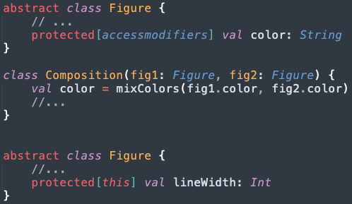
Encapsulation - package scope
Object-oriented Principles
protected[this] = only accessible in the instance and the instances of the subclasses
protected[packagename] = accessible by reference in the package itself and the nested packages

Slide 9
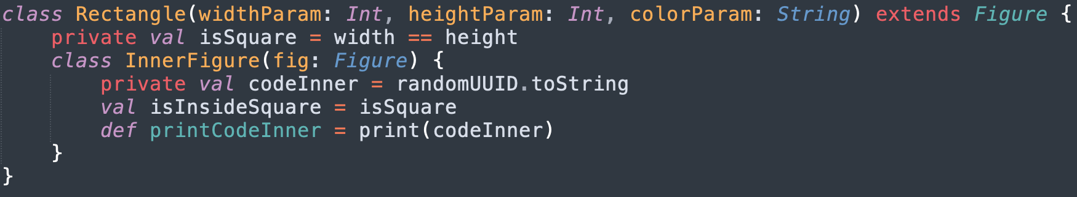
Encapsulation - Nested classes scope
Object-oriented Principles
Private fields of the outer class are accessible from the inner class, as in Java
Private fields of the inner class are NOT accessible from the outer class, unlike in Java

Slide 10
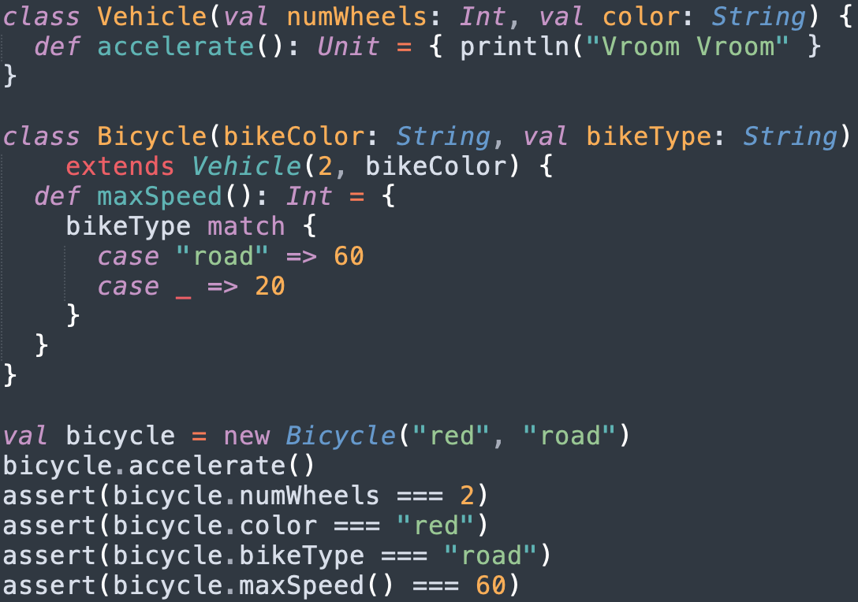
Inheritance
Object-oriented Principles
Subclassing
the subclass will inherit all the non-private fields and methods defined in the superclass

Slide 11
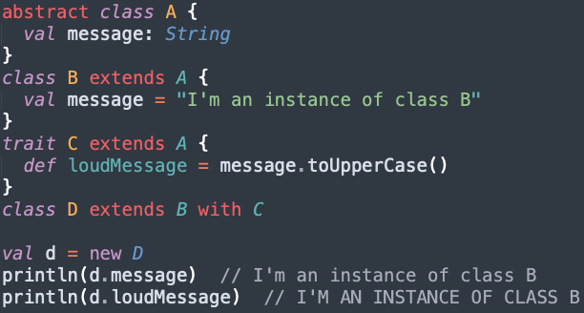
Inheritance
Object-oriented Principles
Mixin-based composition
clean replacement of multiple inheritance

Slide 12
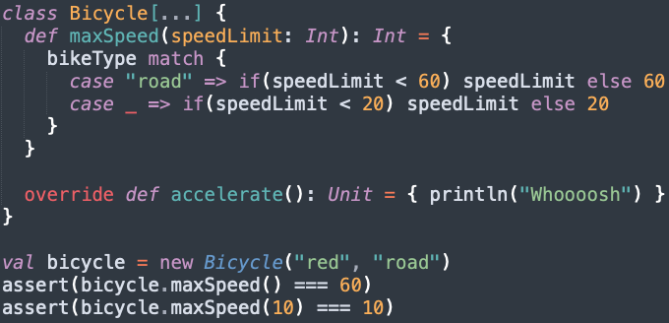
POLYMORPHISM
Object-oriented Principles
Method overloading
Method overriding (override)

Slide 13
Functional
paradigm

Slide 14
remember
Functional paradigm
In functional programming we strive to use pure functions and immutable values
Pure functions
A pure function has two key properties:
It always returns the same value for the same inputs.
It has no side effects.

Slide 15
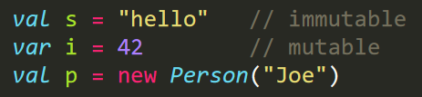

Immutable values
Functional paradigm
Immutability = programming using constants, i.e. the value or state of variables can’t be changed
We can create a new object, but we cannot modify the existing object’s state

Slide 16
First-class functions
Functional paradigm
First-class function = a function that can be:
Assigned to a variable
Passed as an argument to other functions
Returned as a value from other functions

Slide 17
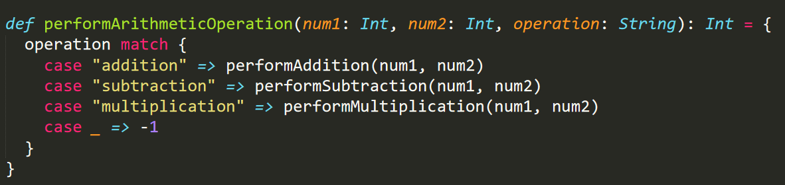
Higher-order functions
Functional paradigm
A higher-order function has at least one of the following properties:
Takes one or more functions as parameters
Returns a function as a result

Slide 18

Anonymous functions
Functional paradigm
Anonymous function = a function that has no:
name
[body]
[input params]
[return type]

Slide 19
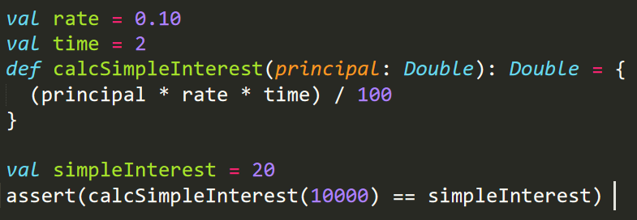
Closures
Functional paradigm
A closure uses one or more free variables
A free variable is a variable that is used in the function but is neither a local variable nor a formal parameter to the function

Slide 20

currying
Functional paradigm
Transforming a function that takes multiple arguments
A chain of calls to functions, each of which takes one argument
Each function returns another function that takes the subsequent argument.

Slide 21

Thank you!
Adrian P. | D. M.

